Slide 1
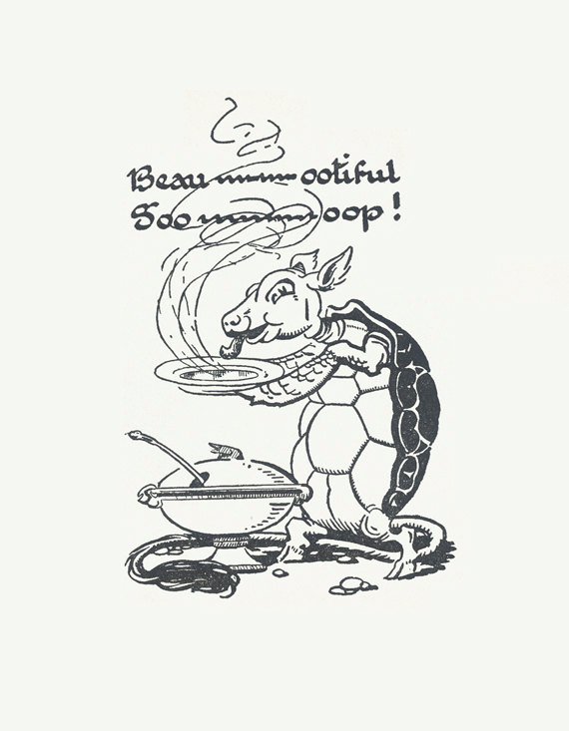
Beautiful Soup

Slide 2
Web Scraping
Extracting information from a website (usually HTML) and parsing it in a readable format (this is called getting soup).
We will be using a package in the Python Library called Beautiful Soup which parses HTML and XML.
Some Best Practices:
Check the Robots.txt to make sure you can web scrape the website. Look for User Agent: *
Scraping too many pages at once quickly can get your IP blocked
Use a browser developer tool to determine the classes of objects (in Chrome you select Inspect)

Slide 3
Pytho 3: pip3 install beautifulsoup4
Python 2.7: pip install beautifulsoup4
conda install -c anaconda beautifulsoup4

Slide 4
IMDB
Monty Python &
The Holy Grail

Slide 5
Our Web Scraping Exercise
Check the Robots.txt of IMDB
Save your Python File and import the packages that you need (Beautiful Soup & Requests)
Parse the HTML 1 url of IMDB: Monty Python Holy Grail’s IMDB if no issues seen in Robots.txt of IMDB
Let’s web scrape the Title, Content Rating, Description of this movie
Let’s create a function to add this information to the key of the ID of this IMDB Page eg: if we put tt0071853 into the function it will return the information in 4 as a dictionary.

Slide 6
Notes:
https://www.crummy.com/software/BeautifulSoup/bs4/doc/#making-the-soup

